Slide 1
TRAINING MANAGEMENT MODULE WORKFLOW

Slide 2
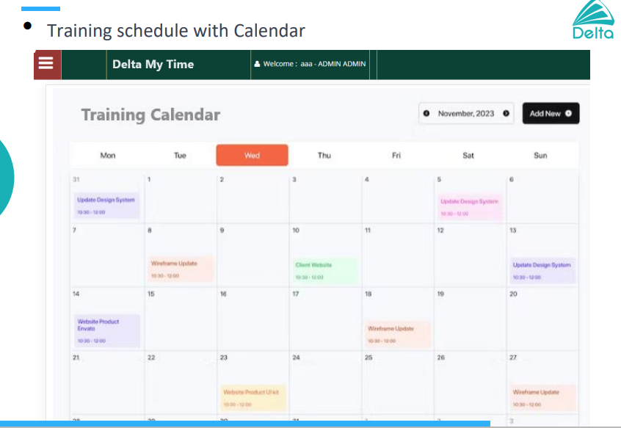
WORKFLOW
Training Calendar
1. Training Calendar
Once a year – Calendar
Update monthly once

Slide 3
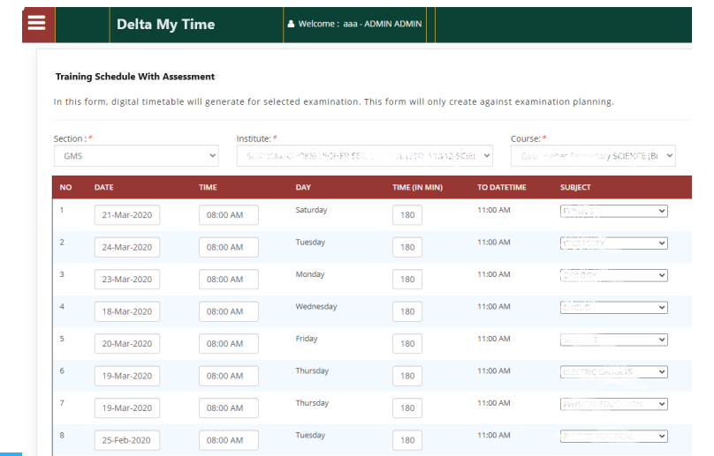
WORKFLOW
Training Schedule
Training Schedule
- Add participants who needs to attend (Office)
- Add the name list to intimate Supervisors ( Shopfloor)
Training Domain
- Training provided by which function
Training Participants
- Excel
- Whole department
- Individual allocation
Training Intimation
- Email
- Mail to Supervisor
Option - Type of training - IDP, General, Self-training
Option – Effectiveness Evaluation – Yes/No
Effectiveness Evaluation Time period – 3 or 6 months

Slide 4
Pre and Post Questionnaire
URL from Microsoft Forms – Admin Access
Download responses from Forms and attach in app
Attendance and Feedback
Other Details
Single Form for Attendance & Feedback
QR code for individual trainings
Direct access from module for office and QR need to be circulated by Trainer
All employees will have access to training portal
- Questions
- Attendance & Feedback
Portal can be accessed by Email ID & Mobile No. – Individual Login
Add Additional Training taken up LinkedIn Learning, Grundfos Learning Centre
Trainer score/ Rating
Training Satisfaction Rate
Training Satisfaction Rate
Certificate for the training conducted

Slide 5
Effectiveness Evaluation form
Clarification:
Trainings that require EFFECTIVENESS EVALUATION
Effectiveness evaluated by Manager after 3/6 months
Attach training documents in the app
Training Reminder to Trainers & Participants
Clarification:
Training time
Clarity between lesson learnt and training
Individual Login for all employees
To access dashboard
Update individual training details
Documents required need to be attached

Slide 6
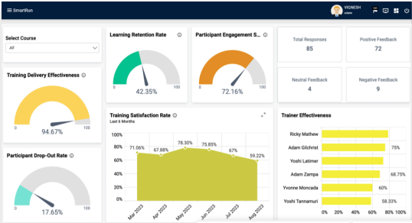
Dashboard
Sample dashboard
Dashboard Content
Total No. of Trainings completed
Total No. of Participants
Training hours
Trainer score/ Rating
Training Satisfaction Rate
Function-wise training conducted
Individual training dashboard
Upcoming training details – month/week
Average training time/ person

Slide 7
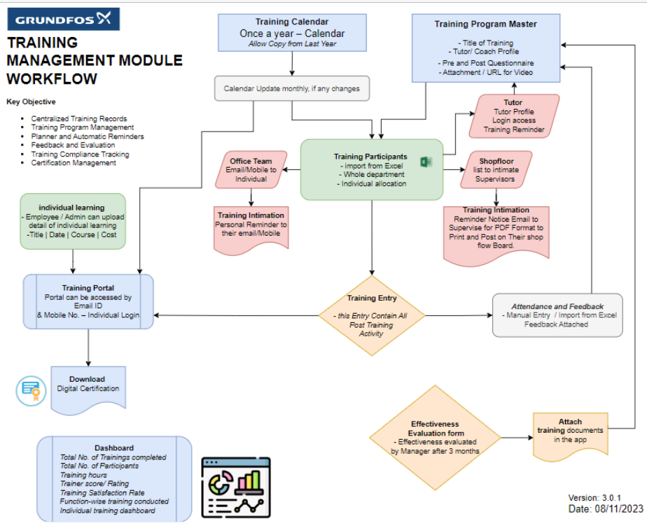
Workflow

